Slide 1
Klöckner Pentaplast company presentation
Name
Location
XX Date 2021

Slide 2
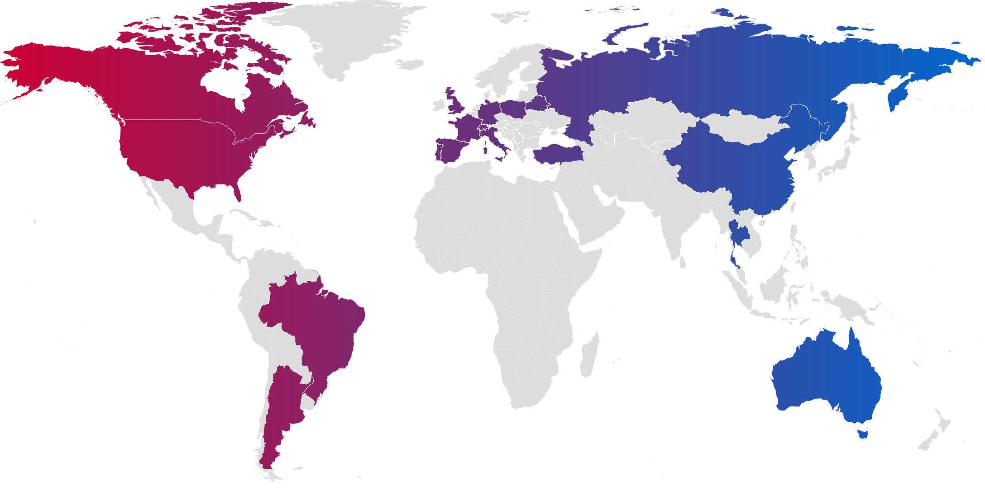
Global footprint
Europe
19 locations
18
countries
31
Plants
11.9 bn Trays
62 kt Flexible Film
595 kt Rigid Film
The Americas
8 locations
Asia & Australia
4 locations
5,900
employees
~€2 bn
annual revenue
1,270
trademarks and patents

Slide 3
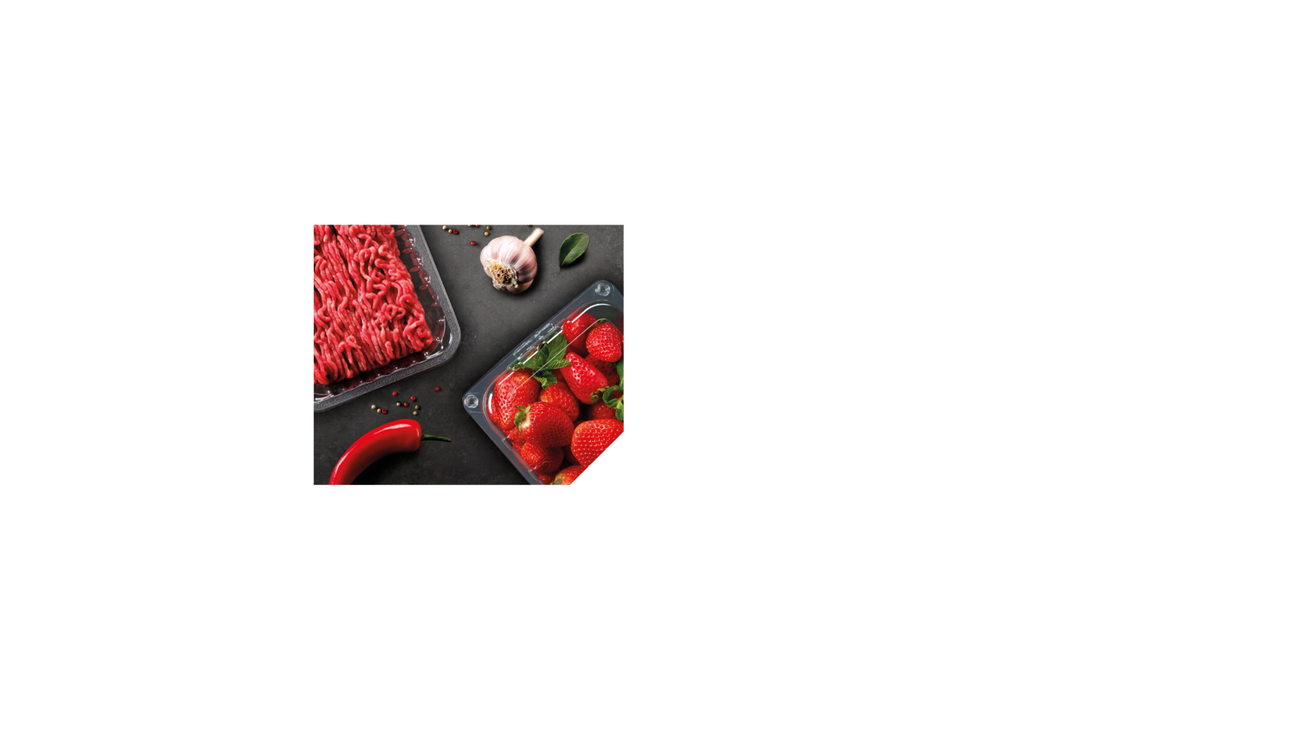
Two divisions
Pharma, Health & Protection and Durables
Food Packaging

Slide 4
Pharma,
Health & Protection and Durables
Health
Pharma
Home, building and constructions
Cards and graphics
Labels

Slide 5
Food Packaging
Bakery
Fruit and produce
Protein
Food to go

Slide 6
About kp
Global leadership
R&D powerhouse
High standards
Value leadership
A global leader in recycled content products and high barrier protective packaging we have 41 manufacturing and distribution facilities in 26 countries with 5,900 employees.
Underpinning our innovations with our customer partnerships and value leadership we have an average vitality index of 12% across our two divisions with more than 600 patents and 700 trademarks.
Our best-in-class productivity with the finest talent in the industry creates added value leadership for trusted partnerships and collaborations with our customers, supplying the sustainable protection of everyday needs.
A capacity of 11.9 billion trays, 62 kilo tonnes of flexible film and 595 kilo tonnes of rigid film, we use our expertise and broad range of products, to develop global leadership in cost-effective solutions.

Slide 7
kp’s vision and culture
Sustainable Protection of Everyday Needs
Core behaviours
Focus Accountability Respect Urgency
Values
Safety Teamwork Sustainability

Slide 8
Our sustainability roadmap
We are investing our time, focus and energy in becoming a better, more sustainable business.
Notes:
SUGGESTED TALKING POINTS
- Talk about the why
Firstly morale imperative, it’s the right thing to do
There is an expectation from external stakeholders (customers, investors, NGO’s, media etc)
But also an expectation from colleagues and future employees
Highlight that PPP has helped us drive great progress, but the sustainability agenda has evolved and so must kp
Will make us a stronger business (e.g. driving efficiency, driver safer environment, stronger supply chain, win new business)
Explain Investing In Better
What does it mean - talk about how it’s investing our time, our focus, our energy etc.
Talk about the fact that it’s everyone’s responsibility
Talk about how we are integrating in to ‘how we run our business’ (e.g BTO, ESG Ratchet etc)

Slide 9
Our three objectives
30% recycled content
30% Tray to Tray
100% packaging recyclable
Close the Loop
0 lost time accident rate
>30% women in management
>80% employee engagement score
One community project per site
Act Responsibly
Zero waste to landfill
Zero incineration without energy recovery
Energy efficiency 17%
Scope 1&2 50% emission reduction
Scope 3 20% intensity reduction
Work Smarter
Notes:
SUGGESTED TALKING POINTS
Introduce the three objectives
Close the Loop
By ‘closing the loop’ we will reduce waste, and do more with less. This objective commits us to using more recycled material, closing the packaging loop and taking every opportunity to make our packaging recyclable.
Work Smarter
We have a responsibility to use as few resources as possible, as efficiently as possible. That’s why we are focused on using less energy, cutting carbon emissions and ending landfill.
Act Responsibly
Acting responsibly at all times is a cornerstone of our culture. And in the future, we will do an even better job of keeping our people engaged, while we continue to focus on safety, and on becoming a more diverse company.

Slide 10
Thank you
www.kpfilms.com

